Slide 1
Project: Employee Timesheet Data Analysis
Overview: Analyzed timesheet data to uncover productivity patterns and reporting behavior among employees.
Key Contributions:
Imported, cleaned, and transformed raw Excel data using Pandas and NumPy.
Standardized column names and converted string-based time fields to proper datetime formats.
Analyzed total reported hours, vacation/holiday usage, and zero-hour submissions.
Created insights like:
Top and bottom 3 employees by total hours.
Weekly timesheet submission trends.
Breakdown of submission statuses (e.g., Approved, Pending).
Visualized date-wise hour trends using Matplotlib and Seaborn.
Presented insights in a PowerPoint report suitable for leadership review.
Tools Used: Python (Pandas, NumPy, Matplotlib, Seaborn), Jupyter Notebook, Excel, PowerPoint
Outcome: Enabled data-driven decisions for workforce planning and time reporting compliance.

Slide 2
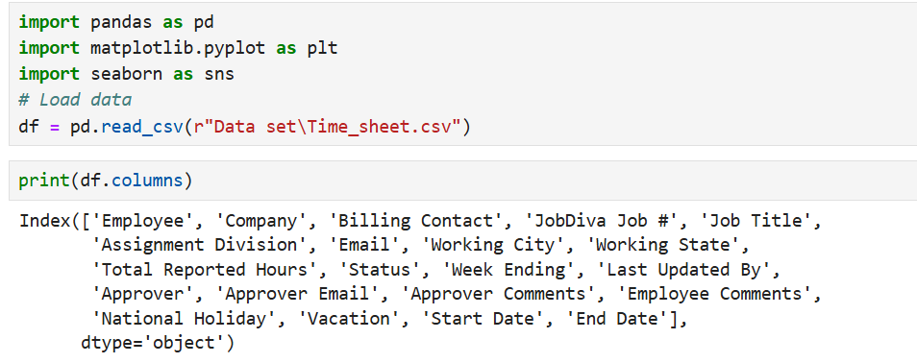
Data Import & Initial Exploration:

Slide 3
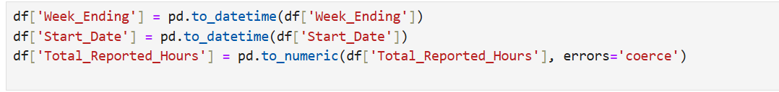
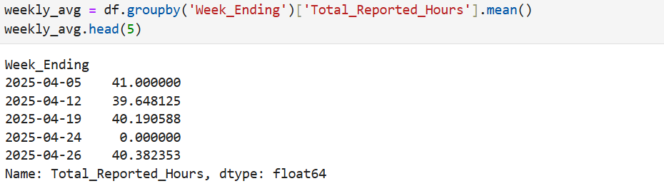
Cleaning and Removing extras Space column names:
Converting date datatype to datetime :
Total_Reported_Hours:

Slide 4
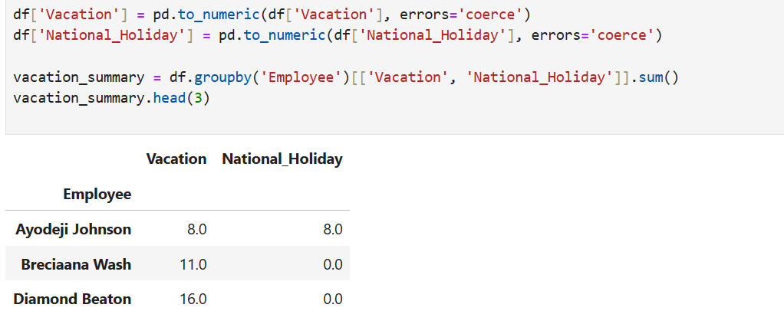
Vacation and Holiday Time usage:

Slide 5
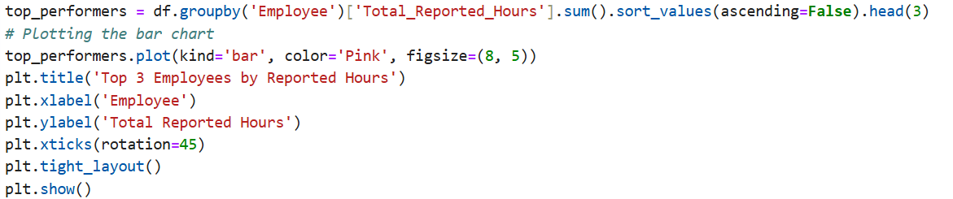
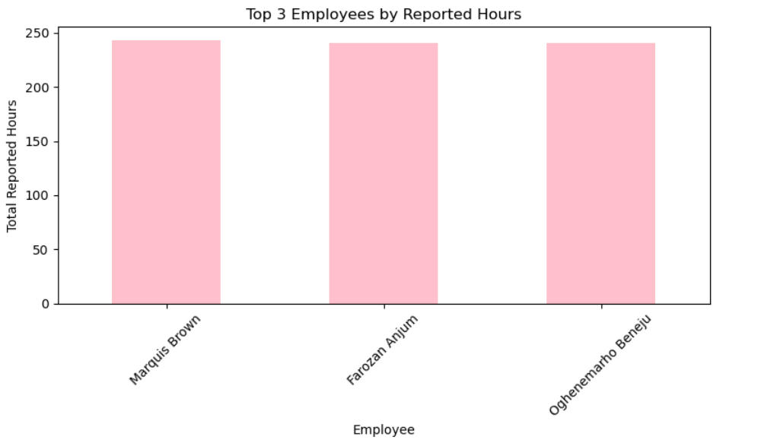
Top 3 Employees by Reported Hours:

Slide 6
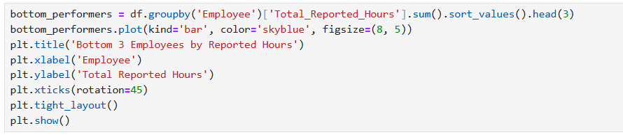
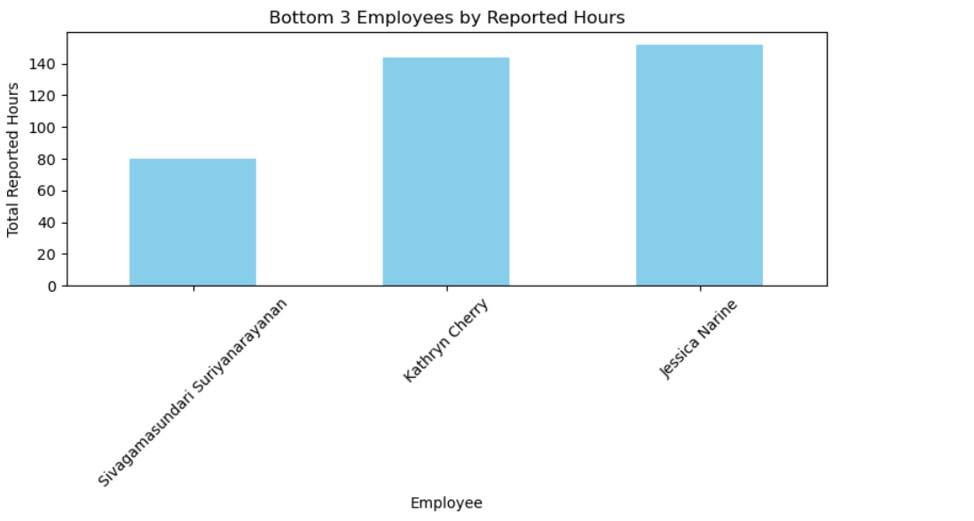
Bottom 3 Employees by Reported Hours:

Slide 7
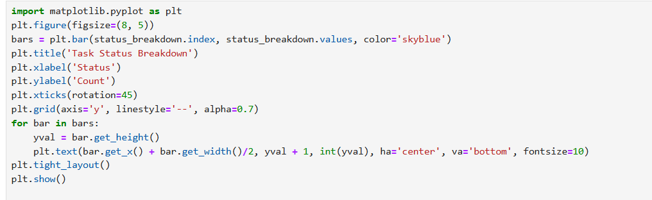
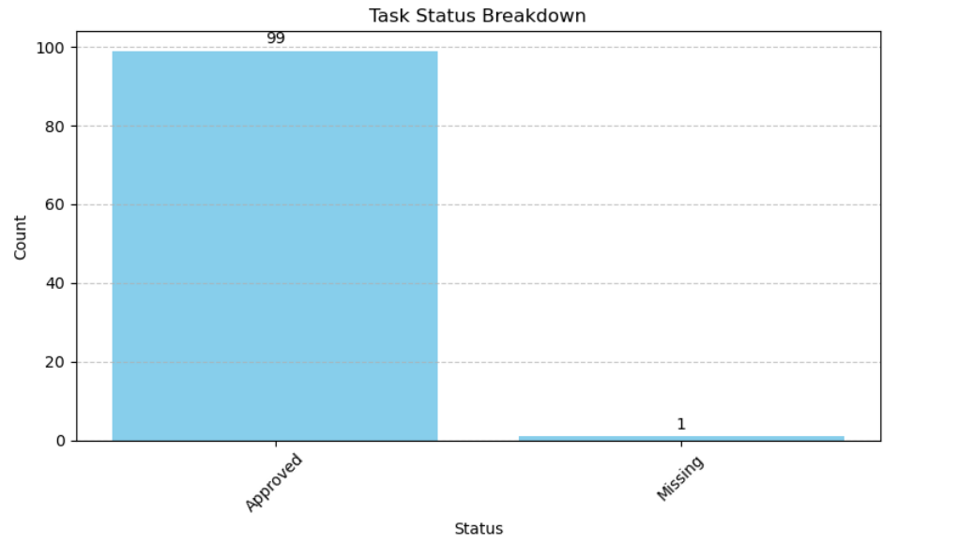
Timesheet Status Breakdown:

Slide 8
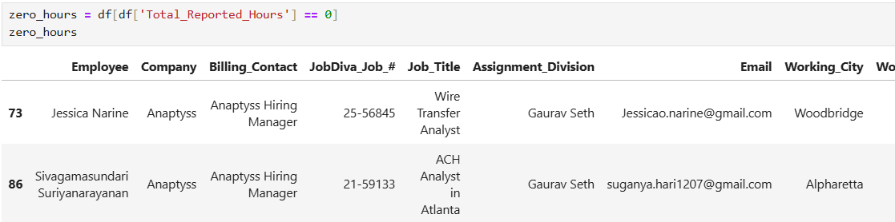
Total Zero Hour Reported:

Slide 9
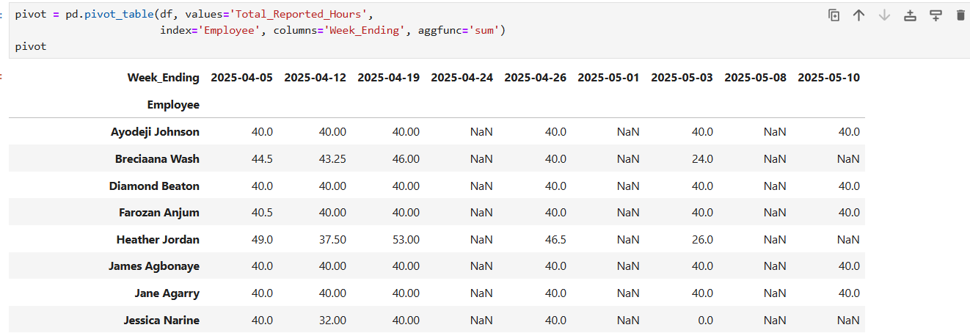
Date Wise hours Representation :

